Slide 1
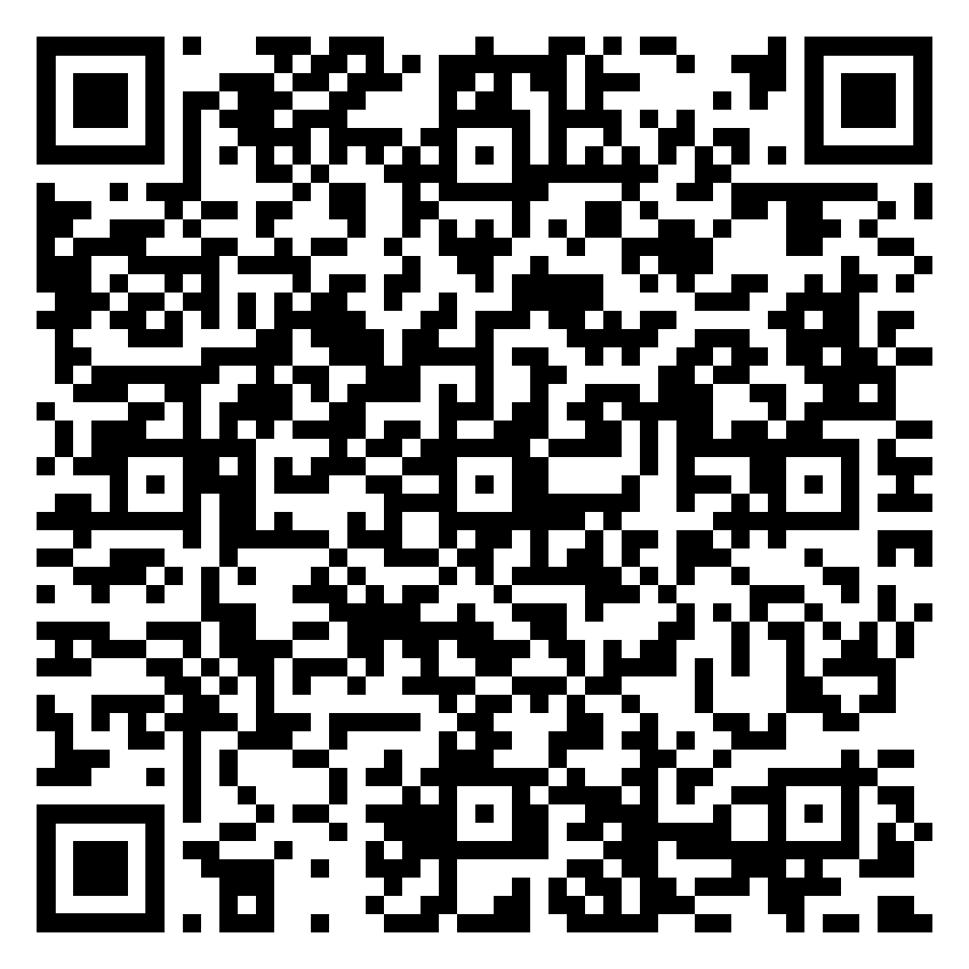
Time to VENT
A weekly, voluntary Peer Support initiative to improve colleague wellbeing and promote reflective practice
Dr Jonathan Sharpe, Dr Jack Whiting Queen Elizabeth The Queen Mother Hospital, Margate
Introduction
Methods
Trainees of anaesthesia are particularly susceptible to burnout and depression (1,2). Anaesthetists have an increased risk of suicide, and, reliance on alcohol and recreational drug use, when compared to the general public and other medical professionals (3,4).
The Association of Anaesthetists of Great Britain and Ireland suggest that interventions warrant further research, leading to campaigns such as “#CoffeeAndAGas”. The association ‘encourages other departments to consider implementing similar initiatives for the benefit of their trainees’ (5). Therefore, we introduced VENT Peer Support for junior anaesthetists within our hospital.
Aims: Promote wellbeing through offloading, reflection and sharing experience; and, to promote culture change.
A Pre-intervention survey showed, within our department, on call shifts cause stress that negatively impacts wellbeing beyond shifts and there is not always someone who understands their job role to talk to. Trainees do not want to speak to consultants or supervisors about wellbeing issues. Therefore, weekly VENT PS sessions were conducted.
Sessions were structured for familiarity making a comfortable, open environment (Fig.1 ). A survey was sent to participants after 4 sessions
Results
VENT PS Sessions
Weekly 30-minute sessions
Voluntary engagement
Mutual respect
Complete confidentiality
Non-judgmental discussion
No consultant presence
Voluntary attendance was sustained at 95% of available trainees. 10 (90%) responded to the post session surveys. All respondents believed the sessions were helpful for wellbeing, were valuable for learning and most saw value in learning wellbeing theory. All felt the sessions will promote “cultural change” and have a positive impact on overall wellbeing and VENT PS should be offered by other hospitals.
V - Vocalising how I feel helps
me reflect on my own wellbeing
T - Discussing cases has made me more reflective
E - Listening to others’ experiences helps me
reflect on my own problems and how to manage
N - Learning mindfulness techniques or wellbeing theory has helped me consider my own wellbeing
Vocalise how you really feel on that day
Empathise, share similar experiences and feelings
New wellbeing concept or mindfulness technique taught
Talking about cases or on call situations, the majority of the session
Fig 2: Selected results from core aspects of VENT from post session survey taken by participants
“Great sessions. It’s so helpful to know that other people have been affected by the things they have seen too and talk through how to process some of the difficult situations we can find ourselves in. Brilliant initiative and I’m very keen to keep these sessions going!”
“I feel so relieved and reassured when speaking to senior trainees and realising that they went through the same issues as me. These sessions improve my confidence and relieve some of my stress, and genuinely contribute to making me a better anaesthetist”
References
Conclusion
Junior anaesthetists feel more comfortable speaking to other juniors about wellbeing issues than consultants. They felt being able to talk about things that have happened to them on call beneficial. Promoting an open environment exceeded expectations of colleague engagement with most colleagues attending regularly. All felt they learnt from others experiences, but also, revisiting their own experiences allowed them to become more reflective, and, learning about wellbeing theory beneficial. Overall, regular VENT sessions have an overall positive impact on personal wellbeing of our trainees which should become embedded into practice and adopted by other hospitals.
Fig 1: Principles & Structure of VENT PS sessions
Acknowledgments – There are no declarations of interest or sponsorships

